Slide 1




Slide 2



Slide 3


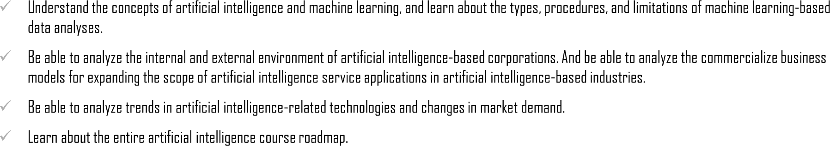


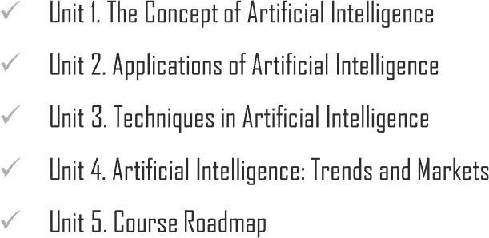
Chapter Description

Slide 4


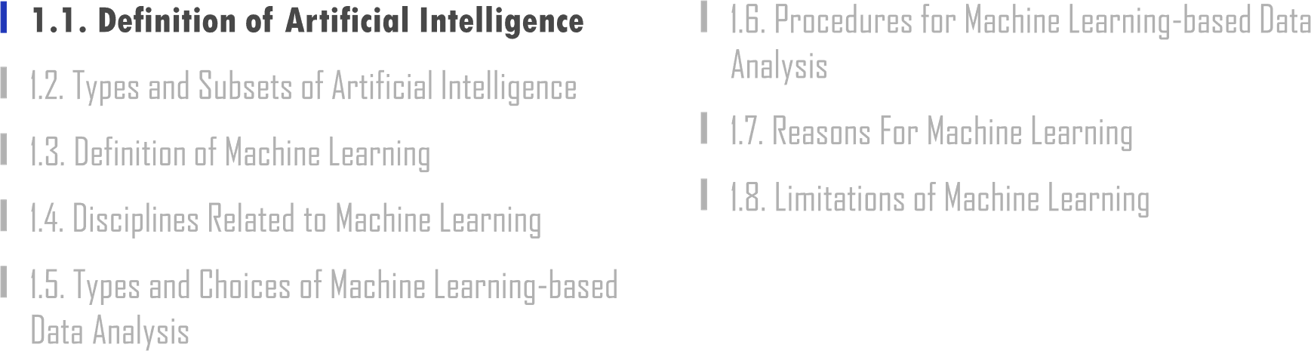

Slide 5
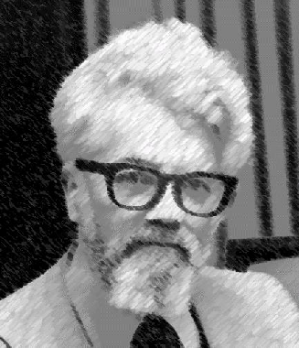
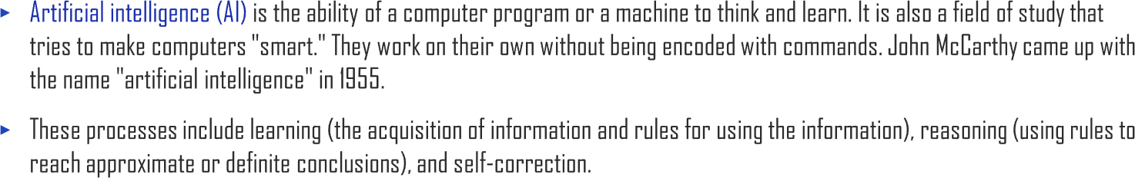

1.1. Definition of Artificial Intelligence
UNIT 01

Slide 6
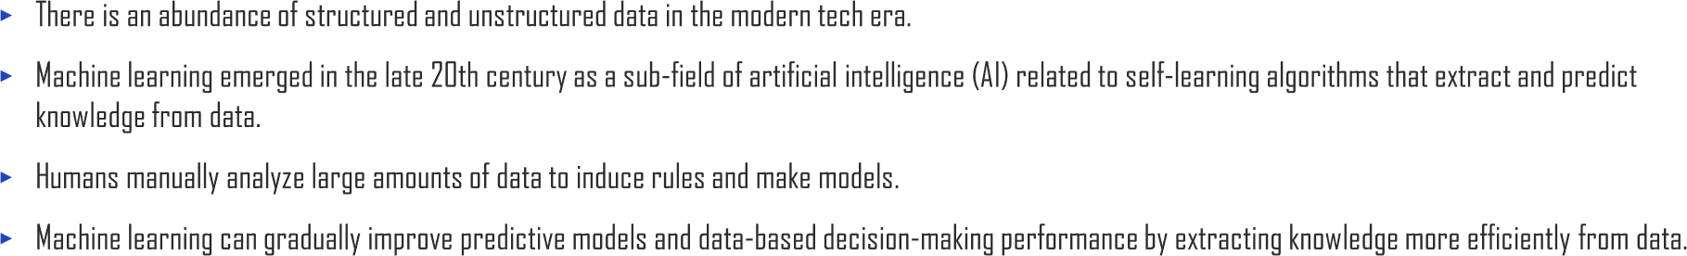
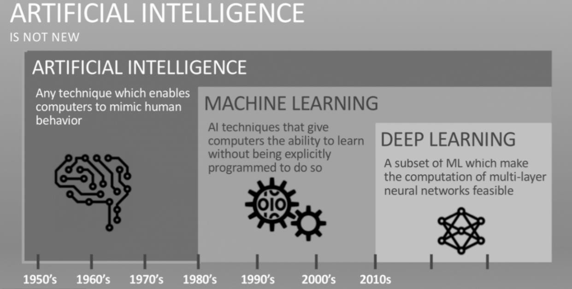

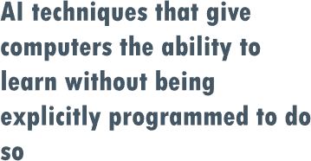

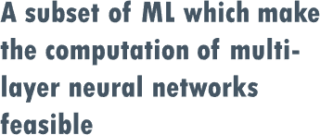

1.1. Definition of Artificial Intelligence
UNIT 01

Slide 7
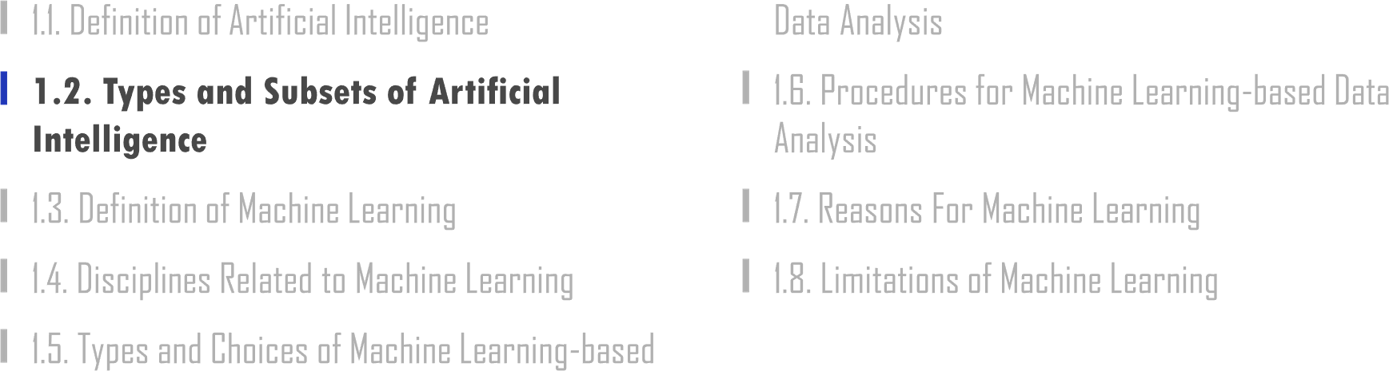

Slide 8
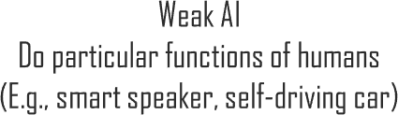

1.2. Types and Subsets of Artificial Intelligence
UNIT 01
Artificial Intelligence
A type of artificial intelligence that covers specific functionality humans can do
Majority of recent technological advancement has occurred in this area
A type of artificial intelligence that can perform all the activities humans can do
Technological advancement in AGI is relatively slower than that in ANI
Main focus of this lecture and the entire course

Slide 9


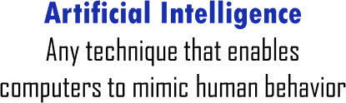


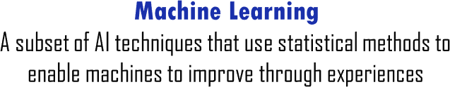


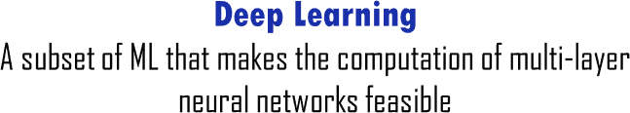

1.2. Types and Subsets of Artificial Intelligence
UNIT 01

Slide 10
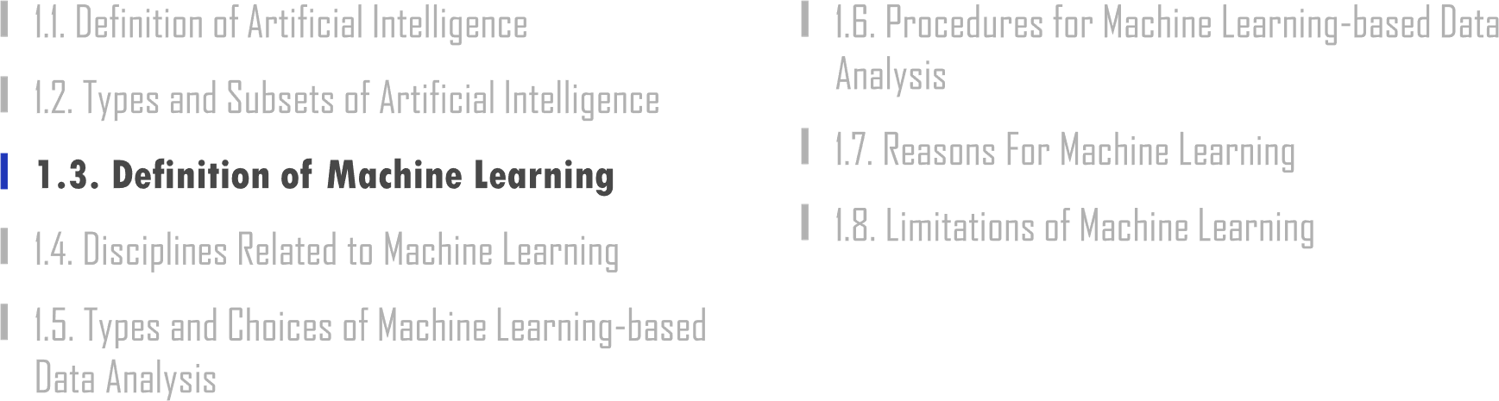

Slide 11
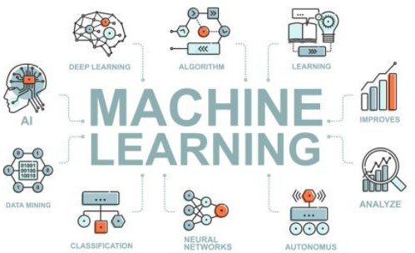




1.3. Definition of Machine Learning
UNIT 01

Slide 12
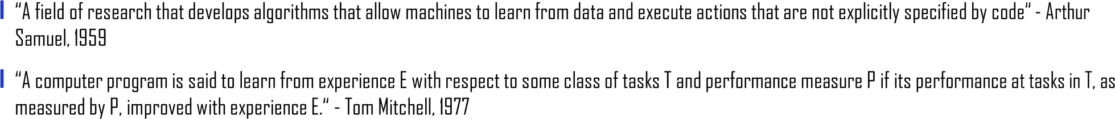
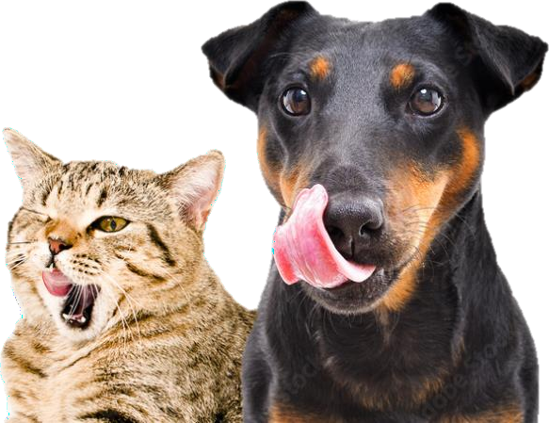
1.3. Definition of Machine Learning
UNIT 01

Slide 13
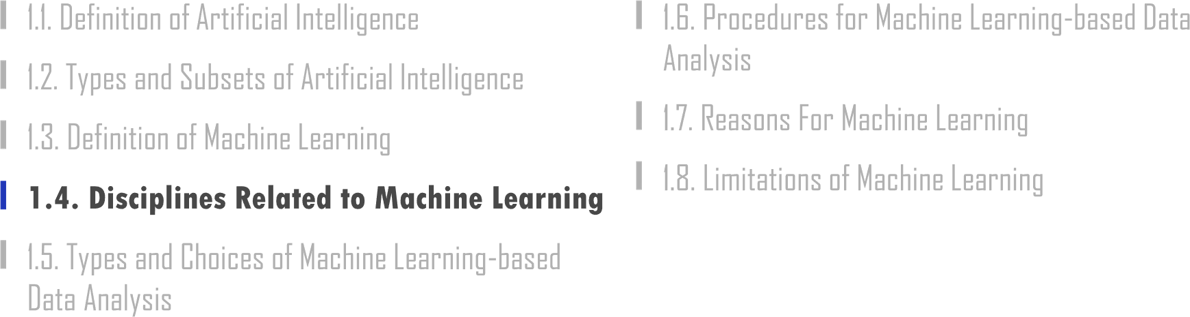

Slide 14
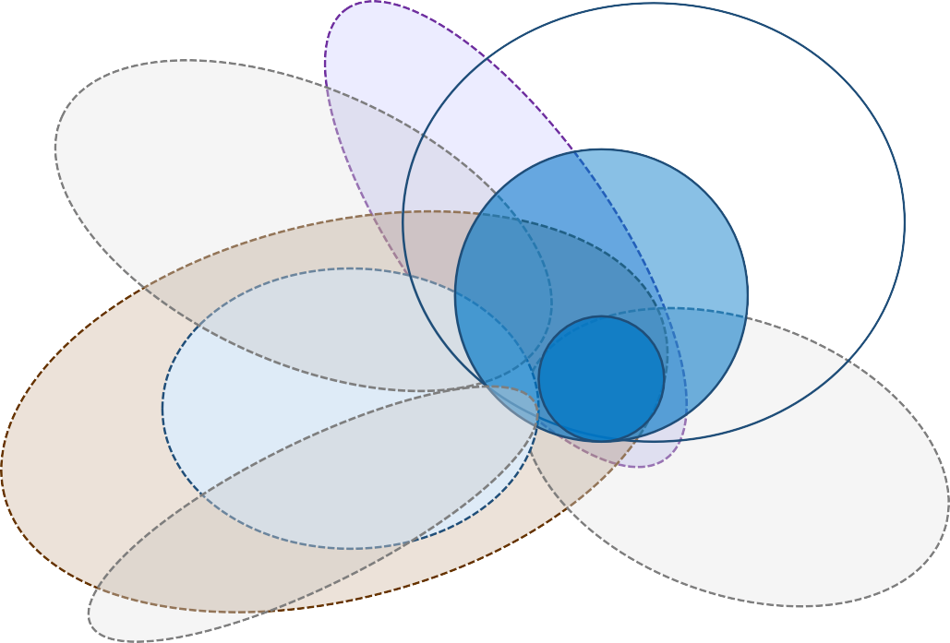

1.4. Disciplines Related to Machine Learning
UNIT 01
Pattern Recognition
Artificial Intelligence
Statistics
Machine Learning
Deep Learning
Data Science
Data Mining
Computational Neuro Science
Database

Slide 15

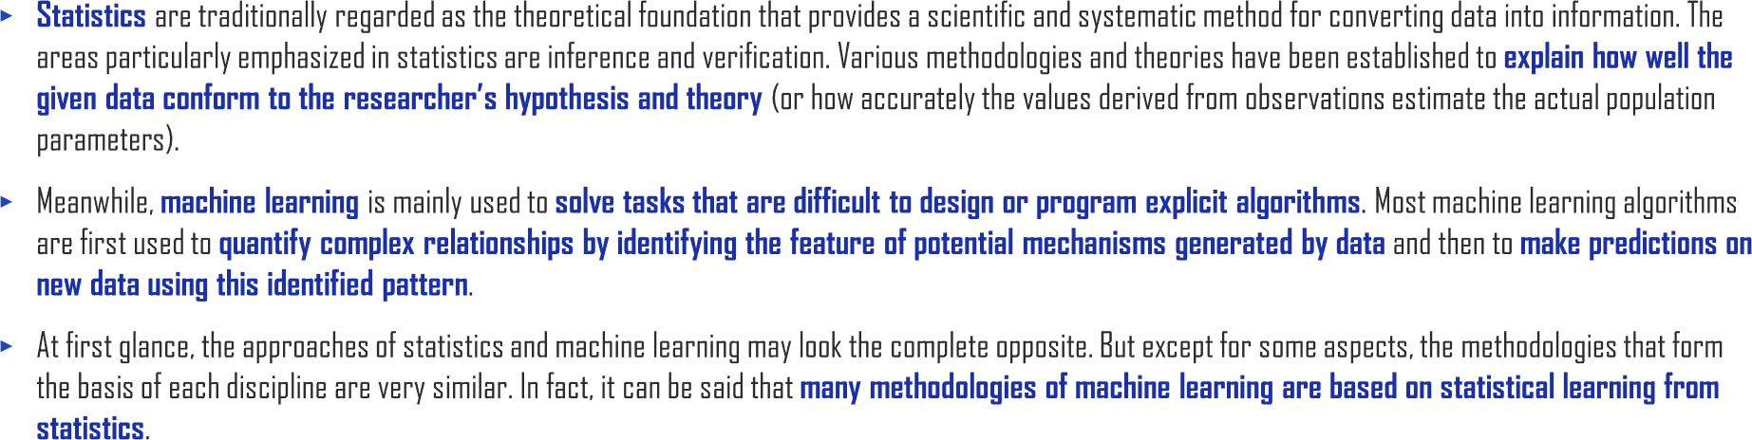
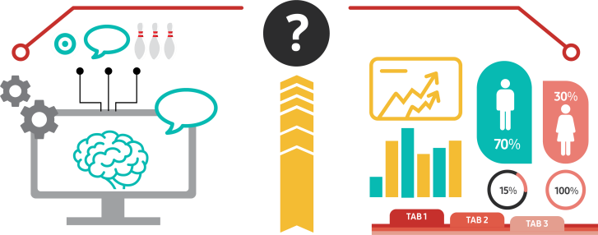
1.4. Disciplines Related to Machine Learning
UNIT 01
Machine Learning
Statistics

Slide 16
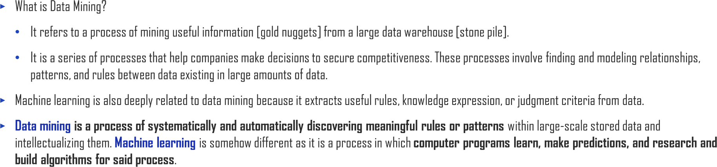

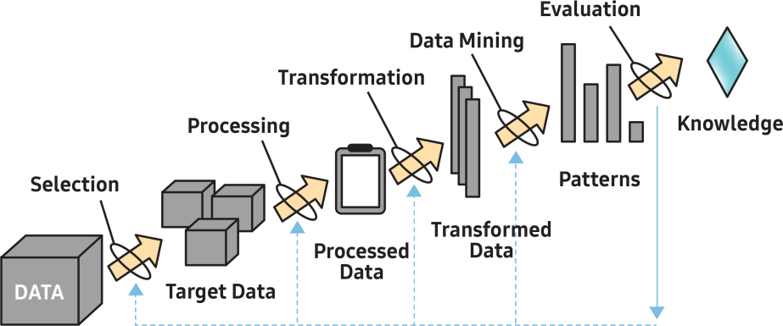
1.4. Disciplines Related to Machine Learning
UNIT 01

Slide 17
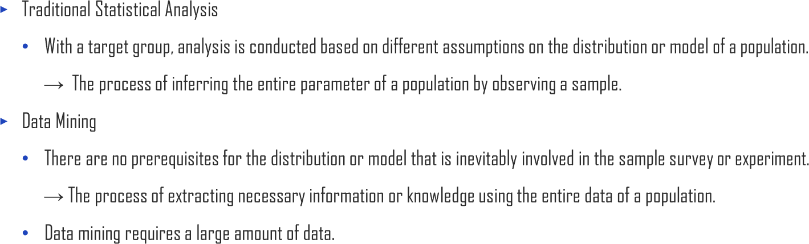
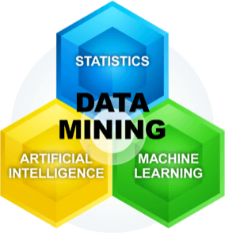
1.4. Disciplines Related to Machine Learning
UNIT 01

Slide 18
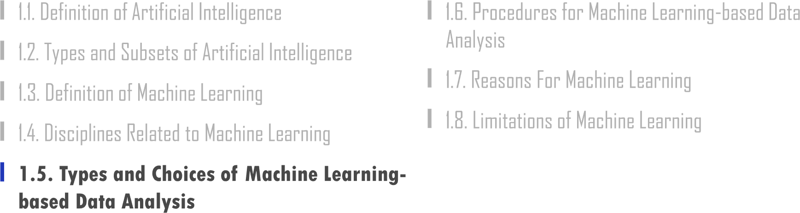

Slide 19








1.5. Types and Choices of Machine Learning-based Data Analysis
UNIT 01
Machine Learning Workflow
IMAGES
FEATURES
MACHINE LEARNING
WHAT THE OBJECT IS

Slide 20
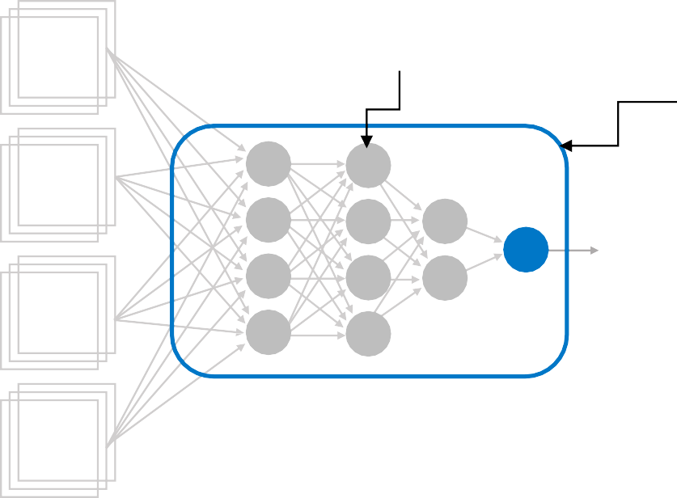





1.5. Types and Choices of Machine Learning-based Data Analysis
UNIT 01
Deep Learning Workflow
Neural networks were initially inspired
by the brain, but the details of how they work are almost completely unrelated to how biological brains work.

Slide 21
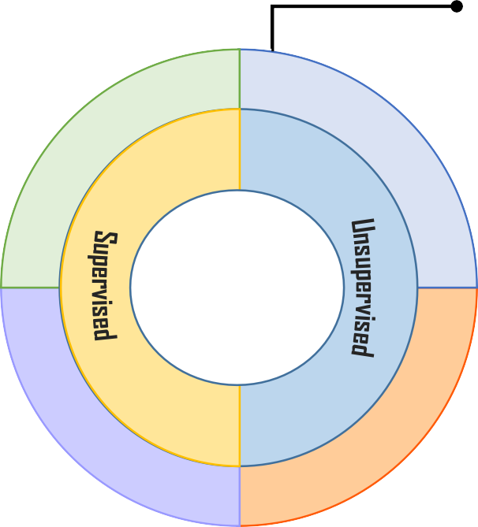




1.5. Types and Choices of Machine Learning-based Data Analysis
UNIT 01
Prediction
Making a model based on a given data, then applying the model to new cases for
predictions
Predicting the quality specifications from ingredients and environment (pressure, temperature, humidity, etc.) in the fishing
industry
Clustering
Comparing the properties of the data and forming clusters based on similar characteristics
Clusterization of processes with similar characteristics out of various processes
Data Mining Problems
Association Rule
Identifying the attributes or relationships between items to which the appearance of a pattern implies the appearance of another pattern
Predicting what will happen to the entire process when there is an abnormal pattern in one process
Classification
Determining where a particular case belongs in a given series of classified categories
Quality Ratings from good/normal/bad, Determining the quality of new products

Slide 22
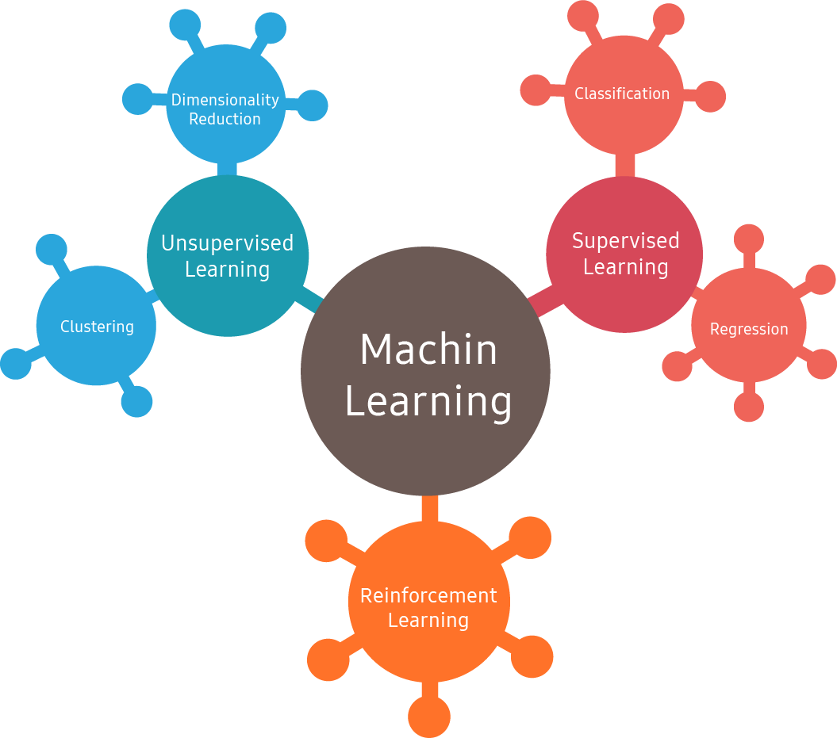
1.5. Types and Choices of Machine Learning-based Data Analysis
UNIT 01
Big data
Supervised
Learning
Machine
Regression
Customer Segmentation

Slide 23

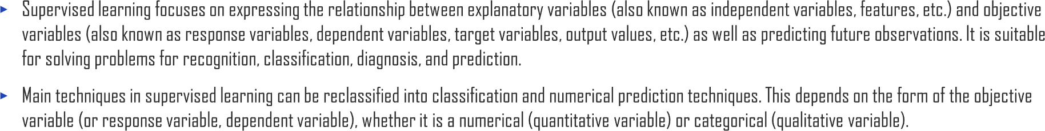







1.5. Types and Choices of Machine Learning-based Data Analysis
UNIT 01
Labeled Training Set for Spam Classification (Example of Supervised Learning)
Training Set
Label
Sample
New Sample

Slide 24
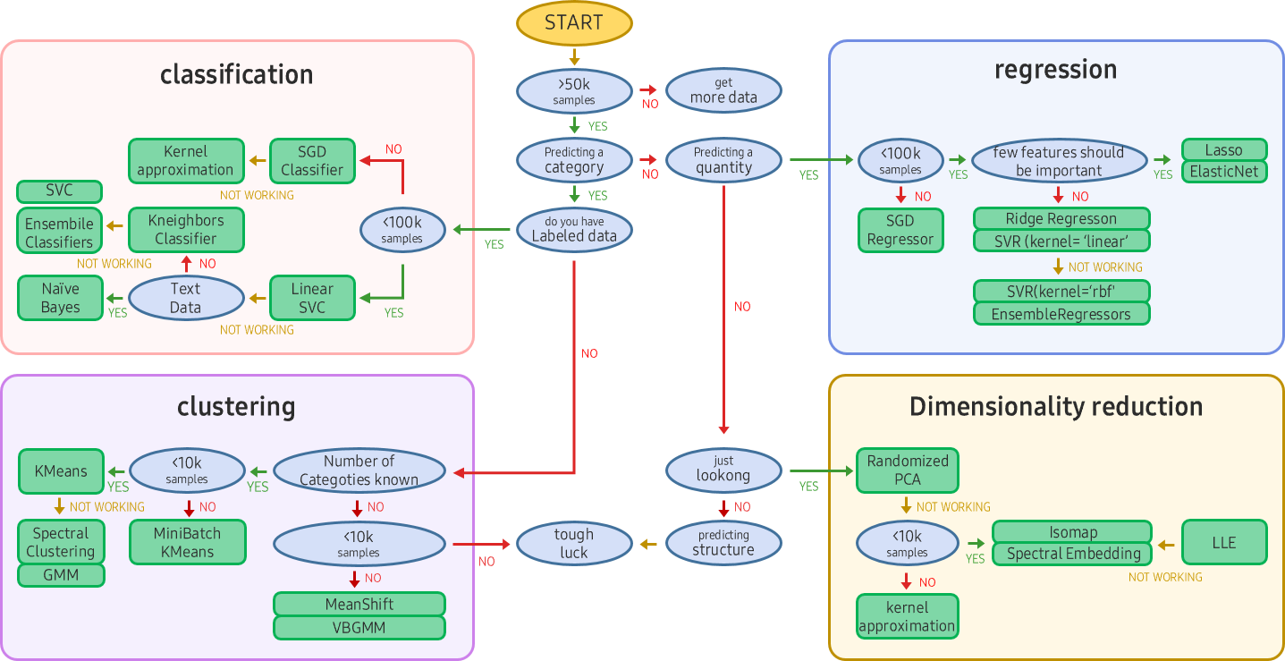
1.5. Types and Choices of Machine Learning-based Data Analysis
UNIT 01
kernel
approximation
Ensemble
labeled data
Classifiers
SVR (kernel=‘linear’)
SVR (kernel=‘rbf’)
number of categories known
scikit-learn algorithm cheat-
sheet

Slide 25
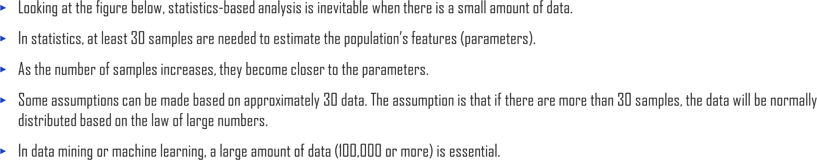
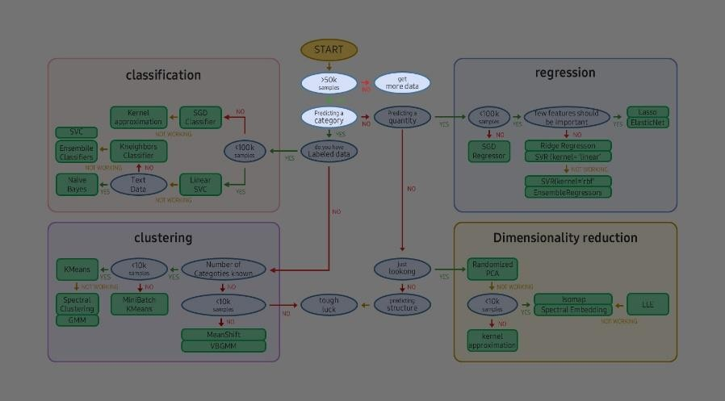
1.5. Types and Choices of Machine Learning-based Data Analysis
UNIT 01
get
more
data
No
>50
samples
YES
predicting a
category

Slide 26
1.5. Types and Choices of Machine Learning-based Data Analysis
UNIT 01
kernel
approximation
Ensemble
labeled data
Classifiers
SVR (kernel=‘linear’)
SVR (kernel=‘rbf’)
number of categories known

Slide 27
1.5. Types and Choices of Machine Learning-based Data Analysis
UNIT 01
Type | Regression (Numerical Prediction)

Slide 28
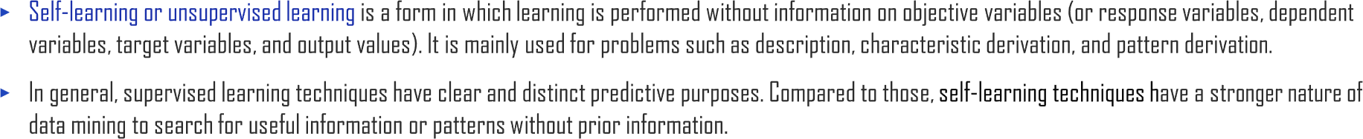
1.5. Types and Choices of Machine Learning-based Data Analysis
UNIT 01
kernel
approximation
Ensemble
labeled data
SVR (kernel=‘linear’)
Classifiers
SVR (kernel=‘rbf’)
number of categories known

Slide 29


1.5. Types and Choices of Machine Learning-based Data Analysis
UNIT 01
K-Means DBSCAN Hierarchical Clustering Analysis (HCA) Anomaly Detection and Outlier Detection One-Class SVM Isolation Forest | Principal Component Analysis(PCA) Kernel PCA Local Linear Embedding t-SNE | Apriori Eclat

Slide 30
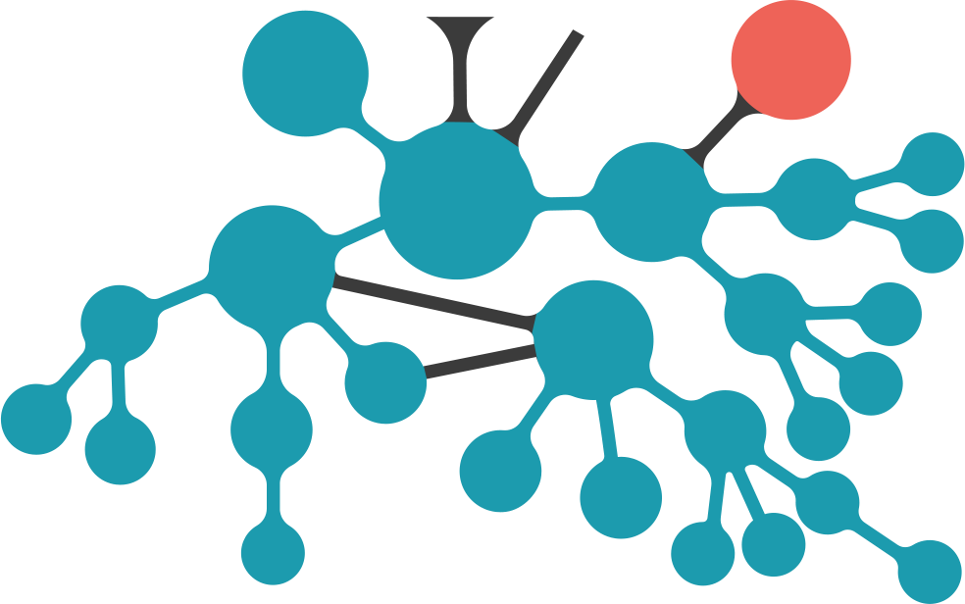
1.5. Types and Choices of Machine Learning-based Data Analysis
UNIT 01
Anomaly detection
Time-series
prediction
AR
continuous
Unsupervised
Learning
Time-series modelling
Markov chain
Latent variable models
CRF undirected
Mixed member- ship
Latent Markov - chain
HMM
discrete
Dimension reduction
under complete
LDS continuous
Clique
decomp.
over complete
SLDS
mixed
Latent Dirichlet
Allocation
Linear
Visualis- ation
Non Linear
Factor analysis
sparse basis
NMF
PLSA
PCA

Slide 31
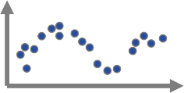


1.5. Types and Choices of Machine Learning-based Data Analysis
UNIT 01
Processing Large Amounts of Data Using Online Learning
Launching
^{많은}A ^{양}Lot^{의}of D^{데}at^{이}a ^{터}
Divide Into Parts
Problem Research
Online Machine Learning
Algorithm Training
Solution Evaluation
Error
Analysis

Slide 32
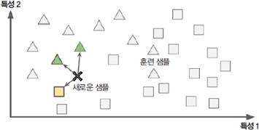
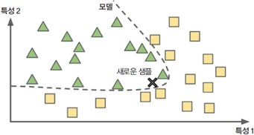
1.5. Types and Choices of Machine Learning-based Data Analysis
UNIT 01
Instance-based Learning
Model-based Learning
Characteristic 2
Characteristic 2
Model
Training Sample
New Sample
New Sample
Characteristic 1
Characteristic 1

Slide 33
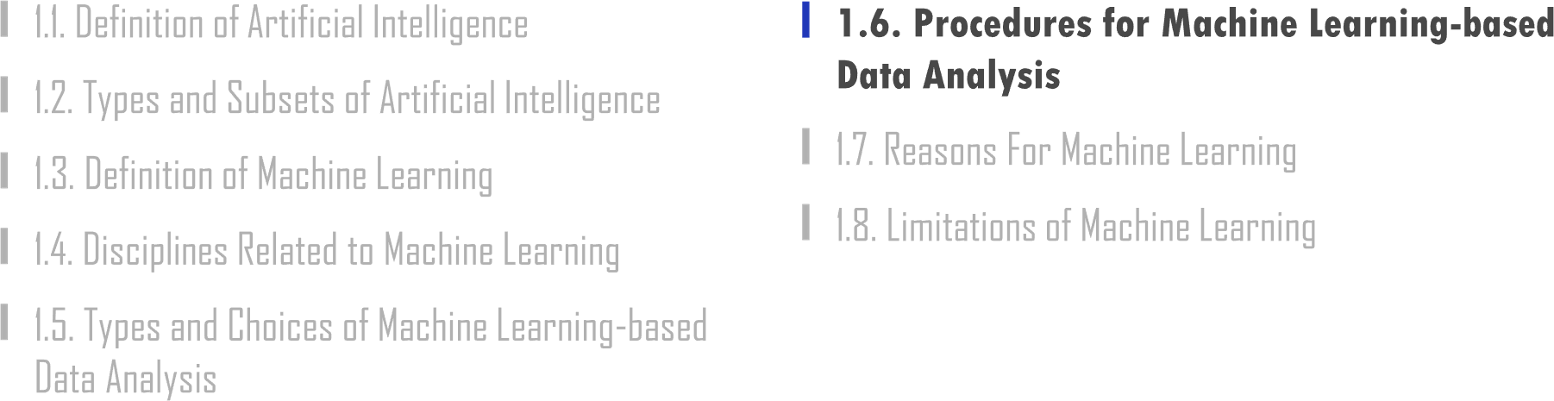

Slide 34





1.6. Procedures for Machine Learning-based Data Analysis
UNIT 01

Slide 35

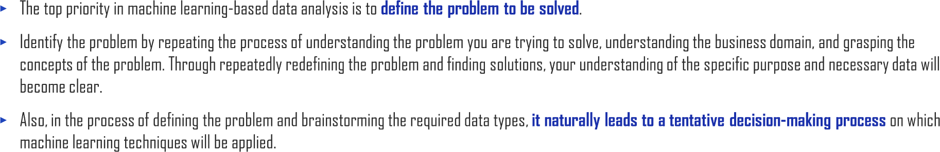

1.6. Procedures for Machine Learning-based Data Analysis
UNIT 01

Slide 36


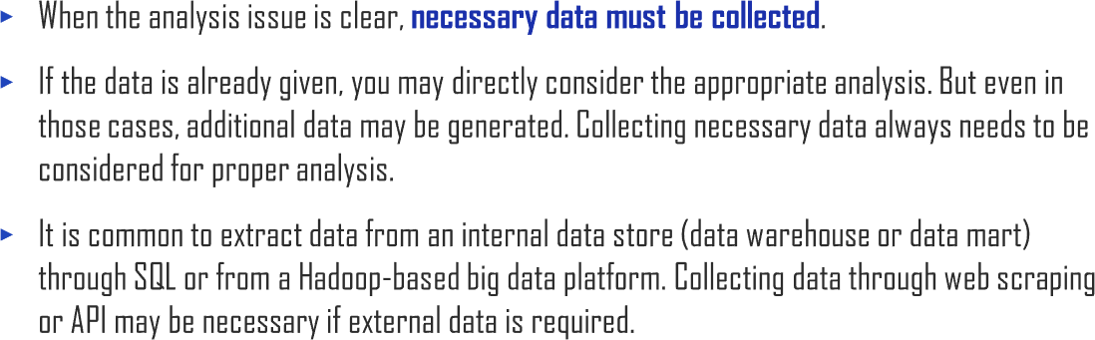
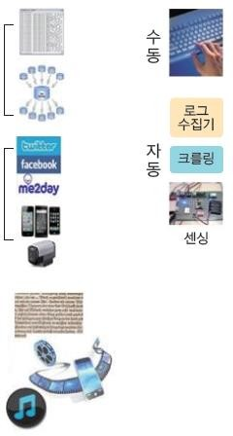
1.6. Procedures for Machine Learning-based Data Analysis
UNIT 01
Data Source
Collecting
Internal
data
Manual
Log Collector
Automated
Web Crawling
External data
Sensing
Media

Slide 37

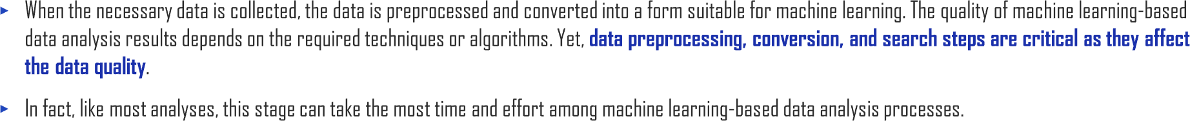
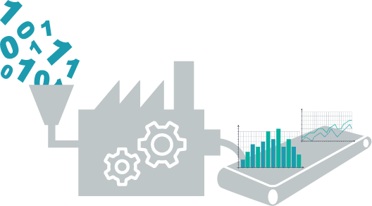
1.6. Procedures for Machine Learning-based Data Analysis
UNIT 01

Slide 38
1.6. Procedures for Machine Learning-based Data Analysis
UNIT 01
Standardization
Z-transform
Normalization (feature scaling)
Sampling
Random Sampling
Stratified Sampling
Cluster Sampling
Normal Distribution
Log Transformation
Square Root Transformation
Dimensionality Reduction
Factor Analysis
PCA
Data Transformation
Categorization
Discretization
Binarization
Signal Data Compression
Fourier Transform
Wavelet Transform

Slide 39
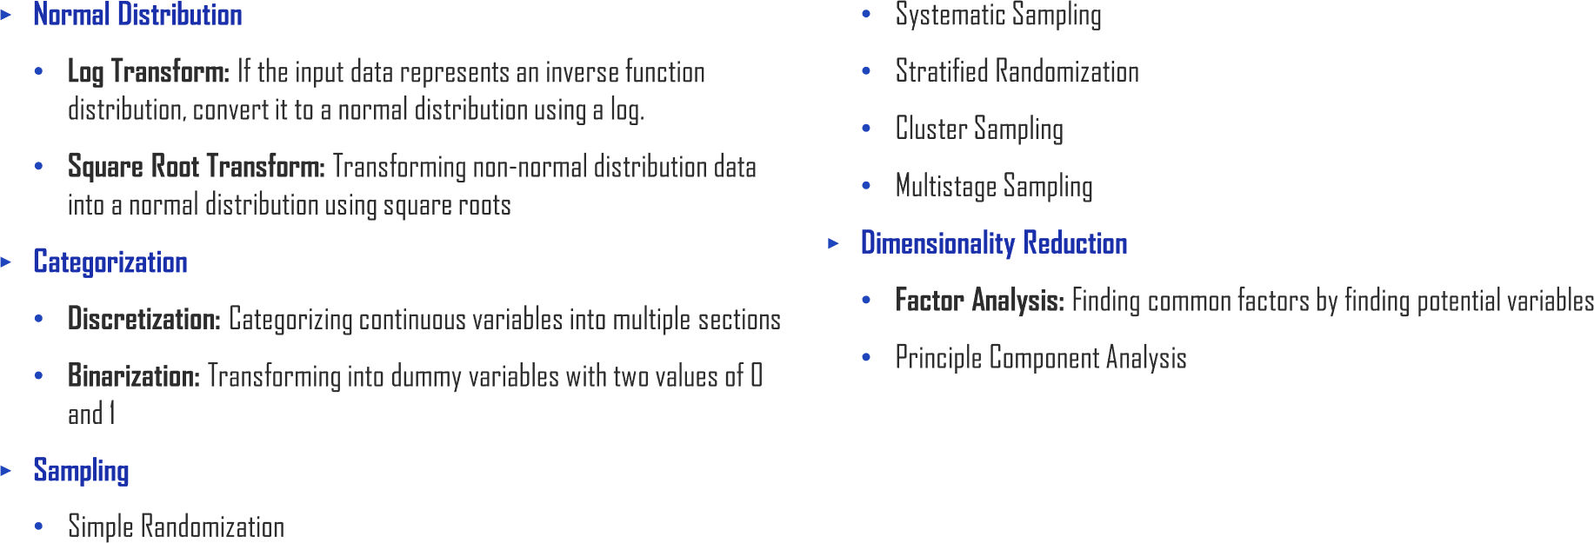
1.6. Procedures for Machine Learning-based Data Analysis
UNIT 01

Slide 40


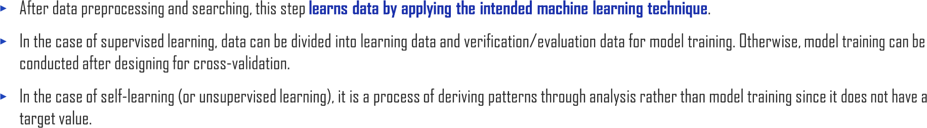
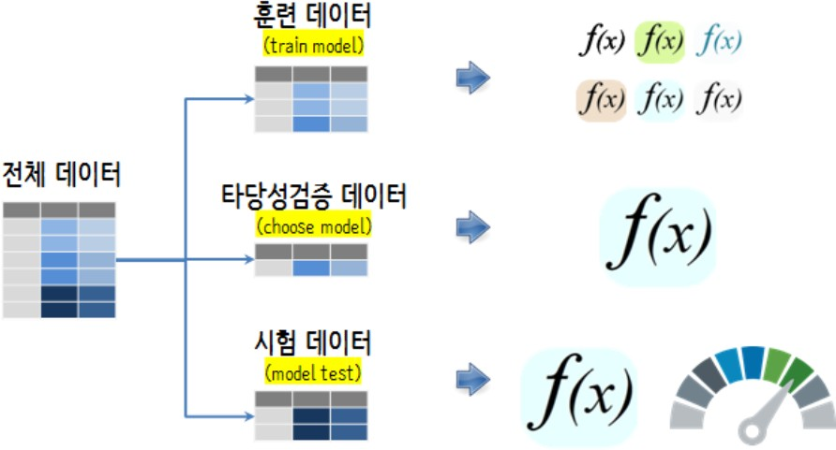
1.6. Procedures for Machine Learning-based Data Analysis
UNIT 01
train model
Entire Data
choose model
model test

Slide 41

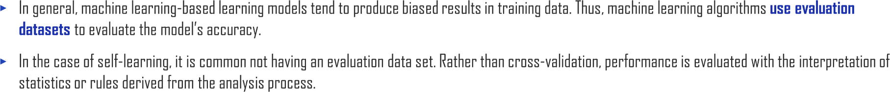
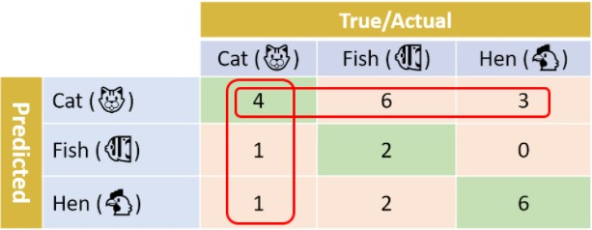



1.6. Procedures for Machine Learning-based Data Analysis
UNIT 01
 |  |  |  |  |  |  |  | True/Actua |  | l
 |  |  |  |  | Cat |  |  | Fish |  |  | Hen
Cat |  |  |  |  |  | 4 |  |  | 6 |  |  | 3
Fish |  |  |  |  |  | 1 |  |  | 2 |  |  | 0
Hen |  |  |  |  |  | 1 |  |  | 2 |  |  | 6
Predicted

Slide 42



1.6. Procedures for Machine Learning-based Data Analysis
UNIT 01

Slide 43


Slide 44


1.7. Reasons For Machine Learning
UNIT 01
Traditional Approach
Launch!
Problem Research
Making Rules
Solution Evaluation
Error Analysis

Slide 45


1.7. Reasons For Machine Learning
UNIT 01
Machine Learning Approach
Launch!
Data
Problem Research
Machine Learning Algorithm Training
Solution Evaluation
Error Analysis

Slide 46


Slide 47



1.8. Limitations of Machine Learning
UNIT 01
₂784
60000
MNIST
Rare Database in a Vast Space

Slide 48

1.8. Limitations of Machine Learning
UNIT 01
Sampling Noise Sampling Bias

Slide 49

1.8. Limitations of Machine Learning
UNIT 01

Slide 50


1.8. Limitations of Machine Learning
UNIT 01

Slide 51


1.8. Limitations of Machine Learning
UNIT 01
𝑦
𝑥 𝑥₀
Graph of an Inaccurate Prediction Due to Overfitting

Slide 52


1.8. Limitations of Machine Learning
UNIT 01
𝑦
𝑥

Slide 53



Slide 54



2.1. Applications of Artificial Intelligence
UNIT 02
A deep learning model can diagnose skin cancer with a near-human accuracy.
Andre Esteva, et al., “Dermatologist-level classification of skin cancer with deep neural networks”, Nature, volume 542(2017), pages 115–118

Slide 55

2.1. Applications of Artificial Intelligence
UNIT 02
Planning
Expert Systems
Robotics
Speech to text
Image Recognition
Speech
Artificial
Vision
Text to speech
Intelligence
Machine Vision
Machine Learning
Natural Language Processing
Deep Learning
Unsupervised
Supervised
Text Generation
Question Answering Content Extraction
Classification
Machine
Translation

Slide 56

2.1. Applications of Artificial Intelligence
UNIT 02

Slide 57

2.1. Applications of Artificial Intelligence
UNIT 02

Slide 58


Slide 59


2.2. Image Recognition
UNIT 02
30
25
20
15
10
5
0
2010
2011
2012
2013
2014
Human
2015
2016
2017
Feature Engineering
Convolutional Neural Networks

Slide 60














2.2. Image Recognition
UNIT 02

Slide 61


Slide 62





2.3. Computer Vision & Machine Vision
UNIT 02
Scientific Research
Natural Resources Management
Protection and Security
Marketing

Slide 63





2.3. Computer Vision & Machine Vision
UNIT 02
Guidance
Gauging
Defect Detection
Packaging Inspection

Slide 64


2.3. Computer Vision & Machine Vision
UNIT 02

Slide 65





2.3. Computer Vision & Machine Vision
UNIT 02

Slide 66



2.3. Computer Vision & Machine Vision
UNIT 02

Slide 67


Slide 68


2.4. Speech Intelligence
UNIT 02
Natural language generation
Text
classification
NLP
Natural language understanding
Information retrieval

Slide 69


2.4. Speech Intelligence
UNIT 02
Speaker verification and speaker identification
Voice recognition
ANALOG AUDIO
ANALOG-TO-DIGITAL CONVERSION
PATTERN RECOGNITION

Slide 70




2.4. Speech Intelligence
UNIT 02
If you say that Taylor Swift is your favorite singer, the AI will repeat the same answer a few weeks later.
HI! I’M BARBIE!

Slide 71


2.4. Speech Intelligence
UNIT 02

Slide 72



Slide 73










3.1. Edge AI
UNIT 03

Slide 74
















3.1. Edge AI
UNIT 03
IQ cameras, Deep Lens
Custom AI chip
Myriad X
AI processor

Slide 75


Slide 76










3.2. Medical Imaging & Diagnostics
UNIT 03
Autonomous AI algorithm based on biomarkers

Slide 77






3.2. Medical Imaging & Diagnostics
UNIT 03
Diabetic Retinopathy Liver and Lung AI Lesion CT-Scan Analysis for Strokes

Slide 78








3.2. Medical Imaging & Diagnostics
UNIT 03
Diabetic Retinopathy
Cornea Disorders
ARMD
Glaucoma
Cataract

Slide 79


Slide 80







3.3. Autonomous Vehicle
UNIT 03
Automation Levels
ADAS¹⁾
Autonomous
Level 4
Level 1
Level 2
Level 3
Level 5
Driver Assistance
Everything on
Partial Automation
Feet Off
Conditional Automation
Hands Off
High Automation
Eyes Off
Full Automation
Mind Off
ACC(Braking) Lane Keeping Auto Emergency Braking
Parallel Park Assist
ACC(Steering) Lane Changing Traffic Jam Assist Overtaking Assist
Highway Driving ~50mph Driver Initiated Lane Change Automated Valet Park Traffic Jam Chauffeur
Highway Driving ~100mph Automated Lane Change Cruising Chauffeur Free Drive
Robo-taxi Autonomous Shuttle All Driving Conditions
Note: 1) ADAS : Advanced Driver Assistance Systems

Slide 81




3.3. Autonomous Vehicle
UNIT 03
Waymo Disengagement Rate
2015
2016
2017
2018

Slide 82


3.3. Autonomous Vehicle
UNIT 03

Slide 83












3.3. Autonomous Vehicle
UNIT 03

Slide 84









































3.3. Autonomous Vehicle
UNIT 03
Drive.ai Momenta Pony.ai | DeepScale Prophesee | Cognata NVIDIA
FULL SYSTEMS
PERCEPTION
LOCALIZATON

Slide 85


Slide 86


3.4. Reinforcement Learning
UNIT 03
DTRs
diagnosis EHR/EMR
Proficiency est. recommendation education games
Adaptive traffic signal control
Adaptive decision control
Healthcare
Education
Transportation
Energy
Environment
Pricing, trading portfolio opt.
risk management
Recommendation e-commerce, OR customer mgmt.
Business Management
Finance
Action
Deep Reinforcement Learning
Interpreter
Science engineering art
Maths, physics chemistry, music drawing, animation
Computer
systems
Topics in computer science
Games
Robotics
Computer vision
Recognition Detection perception
NLP
Go, poker Dota, bridge Starcraft
Sim-to-real co-robot control
Seq. gen. Translation Dialog, QA, IE, IR
Agent

Slide 87

3.4. Reinforcement Learning
UNIT 03

Slide 88


Slide 89




3.5. Conversational AI
UNIT 03
Automated Speech Recognition
Hi, Bixby. Schedule a
meeting at
10 a.m. tomorrow!
Sure, I scheduled a meeting in your calendar.
LISTENING
Natural Language
Generation
Dialog Management
FORMING RESPONSE
OFFERING RESPONSE
Natural Language Understand
COMPREHENDING
Machine Learning & Deep Neural Networks

Slide 90




3.5. Conversational AI
UNIT 03
“Get me an appointment at…”
Duplex business
User
“You’re all set!”
“How long is the wait usually to be seated?”
“Fifteen to twenty minutes usually”

Slide 91


Slide 92



3.6. GAN, XAI, Synthetic Training Data
UNIT 03

Slide 93

















3.6. GAN, XAI, Synthetic Training Data
UNIT 03

Slide 94






3.6. GAN, XAI, Synthetic Training Data
UNIT 03

Slide 95



Slide 96



4.1. AI Trends
UNIT 04
Open source
framework
_{re} Facial _{on}
cogniti
Conversational
Predictive
_{co} Edge _{g}
agents
maintenance
mputin
Application: Computer vision
Application: Natural language processing / synthesis Application:
Predictive intelligence
Architecture
Infrastructure
Cyber threat
hunting
Medical
imaging &
E-commerce
diagnostics
Synthetic
search
training data
Drug discovery
Crop
Back office
Language
monitoring
automation
translation
Anti-counterfeit
Autonomous
Check-out free
navigation
retail
Reinforcement
Advanced healthcare
learning
Clinical trial
biometrics
Auto claims
enrollment
processing
_{o} Network _{n}
_{p}Next-gen rosthetics
Explainable AI
GANs
ptimizatio
Federated
Capsule Networks
learning

Slide 97


Slide 98















$13 Trillion
4.2. AI Markets
UNIT 04

Slide 99


Slide 100


4.3. AI in Sustainable Energy
UNIT 04
Space Intelligence, a British startup, applies machine learning and AI to satellite data to solve environmental problems such as
re-seasoning, allowing the industry to take corrective action.
Google has promised not to use carbon by 2030. At the recent Google I/O 2021 event, the company explained these efforts in detail by announcing plans to use geothermal energy to power data centers in Nevada.
Kate Brandt, Google’s head of sustainability, said, “We are the first company to sign a contract for next-generation geothermal power.”

Slide 101

4.3. AI in Sustainable Energy
UNIT 04

Slide 102


Slide 103

4.4. AI in Financial Services
UNIT 04

Slide 104

4.4. AI in Financial Services
UNIT 04

Slide 105


Slide 106




4.5. AI in Government
UNIT 04
“With design thinking, close partnerships with state officials, and combination of modern technologies, DWD’s solutions are customized to maximize benefits to components,” said Mitchell.

Slide 107

4.5. AI in Government
UNIT 04

Slide 108


Slide 109


4.6. AI in Healthcare
UNIT 04

Slide 110

4.6. AI in Healthcare
UNIT 04

Slide 111



4.6. AI in Healthcare
UNIT 04

Slide 112


Slide 113


4.7. IoT and AI in Agriculture
UNIT 04
In addition, vertical farms are located in urban areas and can produce local food, removing the need for transport miles. Benefits of locally produced crops include reduced CO2 emissions from transport vehicles and potentially reduced consumer prices.
“The collapse of the supply chain caused by COVID-19 and natural turmoil, such as the fires in California this year, shows that the need for predictable and durable product supply can only come from vertical agriculture,” said Storey.

Slide 114

4.7. IoT and AI in Agriculture
UNIT 04

Slide 115




Slide 116




5.1. Artificial Intelligence Course Roadmap
UNIT 05
Supervised Learning
Unsupervised Learning
Ensemble Methods
Reinforcement Learning

Slide 117


Slide 118









5.2. Category of Machine Learning Techniques (Full)
UNIT 05
DIMENSION REDUCTION
(generalization)
Convolutional Neural Networks (CNN)
REINFORCEMENT
UNSUPERVISED
Pattern search
Recurrent Neural Networks (RNN)
Generative Adversarial Networks (GAN)
LEARNING
NEURAL NETS AND
MACHINE
CLASSICAL
Clustering
DEEP LEARNING
LEARNING
LEARNING
Autoencoders
ENSEMBLE METHODS
Classification
Perceptron
SUPERVISED
(MLP)
Stacking
Bagging
Boosting
Regression

Slide 119



Slide 120


